Slide 1
CS 4530 Software Engineering
Lecture 9.2: Strategies for Engineering Distributed Software
Jonathan Bell, Adeel Bhutta, Ferdinand Vesely, Mitch Wand
Khoury College of Computer Sciences
© 2022, released under CC BY-SA
Notes:
Hi, this is professor bell. In this lesson, we’ll look at two common strategies for building distributed software

Slide 2
Learning Objectives for this Lesson
By the end of this lesson, you should be able to…
Characterize the benefits of replication and partitioning in distributed systems
Evaluate the tradeoffs between consistency and availability in distributed systems

Slide 3
Why expand to distributed systems?
Scalability
Performance
Latency
Availability
Fault Tolerance
“Distributed Systems for Fun and Profit”, Takada
Notes:
Recall from last lesson, that we often turn to distributed systems to make our systems scale better, with higher throughput performance, lower latency, greater availability and fault tolerance

Slide 4
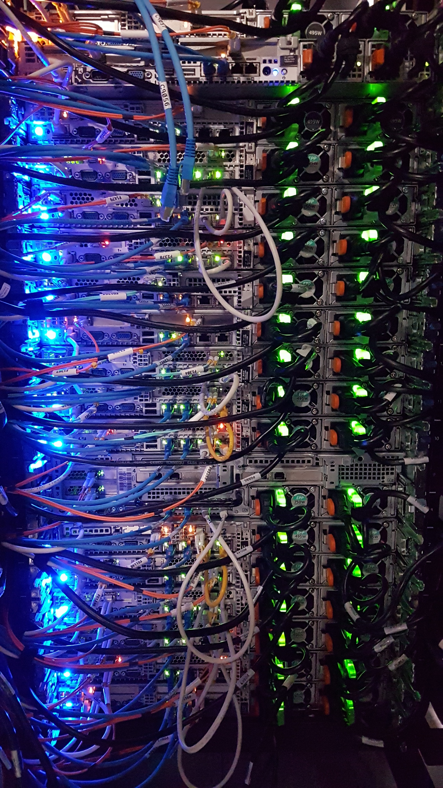
8 Fallacies of Distributed Computing
Sun Microsystems, early 1990’s
}
The network is reliable
Latency is zero
Bandwidth is infinite
The network is secure
Topology doesn't change
Transport cost is zero
The network is homogeneous
There is one administrator
Physical Properties of
networks
Notes:
But, remember that there are limitations that can make it hard for us to get those nice things. For instance: introducing a network into our system can bring new headaches, and today, we’ll see how these fallacies - particularly that the network is reliable - can bite us hard.

Slide 5
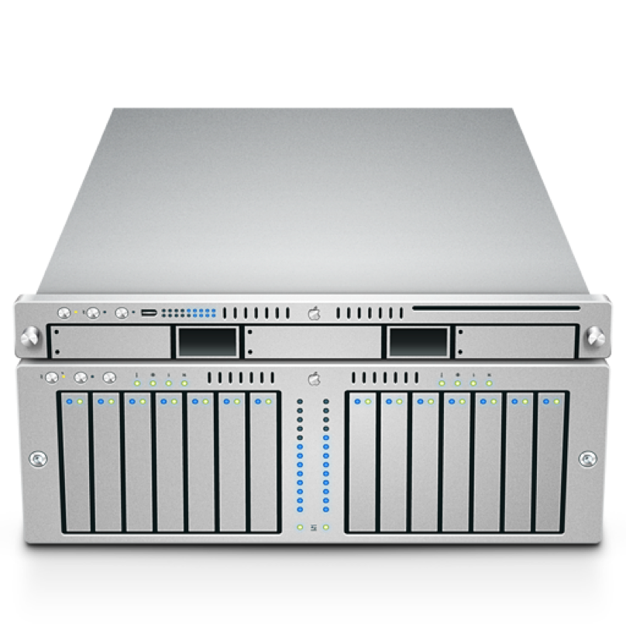

Recurring Solution #1: Partitioning
All accesses go to single server
A
B
Notes:
Partitioning is the simplest strategy that we can employ to improve the scalability of our system

Slide 6

Recurring Solution #1: Partitioning
Divide data up in some (hopefully logical) way
Makes it easier to process data concurrently (cheaper reads)
Each server has 50% of data, limits amount of processing per server.
Even if 1 server goes down, still have 50% of the data online.
A
[0…100]
B [A…N]
A
[101.. 200]
B [O…Z]
Notes:
With partitioning, we divide up data in some (hopefully logical) way. Deciding how to split this data into partitions can be a tricky problem. One easy way to do this is to use some property of the data: if we have 200 records, and they are indexed from 0… 200, you could envision putting the first 100 on one server, and the next 200 on another. Or, split student records by last name: A..N on one server and O..Z on another.
This can improve scalability because we can now process more requests concurrently: each server holds some subset of our data, and if clients want to touch different pieces of that dataset, they can interact with different machines. Even if one server goes down, the rest of the data would still be available.

Slide 7
Recurring Solution #2: Replication
All accesses go to single server
A
B
Notes:
The other recurring solution employed in distributed systems is replication: where we take our service, and take all of that data

Slide 8
Recurring Solution #2: Replication
Entire data set is copied
A
B
A
B
Notes:
And replicate it to multiple servers. In this model, our entire service (and all of the data) is replicated across multiple servers. Ideally, either server can process any request. Hence, we can increase the fault tolerance and performance of our system by having multiple machines that can process requests concurrently, and if one fails, the other can continue to process requests. We can even use this scheme to reduce latency, by placing these replicas in geographically diverse areas. If our replica is physically closer to a client, then it will take less time for a request to get to our server, and a response to get back to the client.

Slide 9
Recurring Solution #2: Replication
Improves performance:
Client load can be evenly shared between servers
Reduces latency: can place copies of data nearer to clients
Improves availability:
One replica fails, still can serve all requests from other replicas

Slide 10
Partitioning + Replication
A
B
Notes:
Of course, most distributed systems combine both partitioning and replication

Slide 11

Partitioning + Replication
A
[0…100]
B [A…N]
A
[0…100]
B [A…N]
A
[0…100]
B [A…N]
A
[101.. 200]
B [O…Z]
A
[101.. 200]
B [O…Z]
A
[101.. 200]
B [O…Z]
Notes:
Where we partition our data, and then replicate those partitions

Slide 12
Partitioning + Replication
A
[0…100]
B [A…N]
A
[0…100]
B [A…N]
A
[0…100]
B [A…N]
A
[0…100]
B [A…N]
A
[0…100]
B [A…N]
A
[0…100]
B [A…N]
A
[101.. 200]
B [O…Z]
A
[101.. 200]
B [O…Z]
A
[101.. 200]
B [O…Z]
A
[101.. 200]
B [O…Z]
A
[101.. 200]
B [O…Z]
A
[101.. 200]
B [O…Z]
DC
NYC
A
[0…100]
B [A…N]
A
[0…100]
B [A…N]
A
[0…100]
B [A…N]
A
[0…100]
B [A…N]
A
[0…100]
B [A…N]
A
[0…100]
B [A…N]
A
[101.. 200]
B [O…Z]
A
[101.. 200]
B [O…Z]
A
[101.. 200]
B [O…Z]
A
[101.. 200]
B [O…Z]
A
[101.. 200]
B [O…Z]
A
[101.. 200]
B [O…Z]
SF
London
Notes:
We can even take this scheme and have arbitrary layers of replication. For instance: we might use the partition + replication scheme from the last slide to organize our system in multiple data centers, where each data center contains its own cluster of machines that partition and replicate the same data. Partitioning and replication are great tools. However, replication is also the source of almost all of the pain in distributed systems.

Slide 13
Replication Problem: Consistency
We probably want our system to work like this
Set A=5
“OK”!
Read A
“5”!
A
B
A
B
6
5
7
6
5
7
Notes:
Replication introduces a new problem, which is: consistency.

Slide 14
Sequential Consistency
AKA: Behaves like a single machine would
Set A=5
“OK”!
Read A
“5”!
Set A=5
A
B
“OK!”
A
B
6
5
7
6
5
7
Notes:
How do we implement replication? Let’s see the classic protocol for replicated data between two machines, and maintaining sequential consistency. Sequential consistency is a fancy way of saying, effectively, that clients can read and write data as if they were interacting with a single server, rather than multiple. The property that we need to guarantee is that before we acknowledge the update to 5, we need to ensure that it’s acknowledged by all machines. A simplification of this protocol, then, is: we provisionally update the value to 5, ask the replica to update it, and only once the replica acknowledge the update, we acknowledge it too. Future reads are then guaranteed to see that new value.

Slide 15
Availability
If at least one node is online, can we still answer a request?
Read A
Set A=5
Set A=5
A
B
A
B
5
6
7
6
7

Slide 16
Consistent + Available
On timeout, assume node is crashed
Read A
Set A=5
“OK”!
“5”!
Set A=5
Assume replica failed
A
B
A
B
6
5
7
6
7

Slide 17
Recall: Fallacies of Distributed Systems
What if the network fails?
Set A=5
“OK”!
Read A
“6”!
Set A=5
Assume replica failed
A
B
A
B
6
5
7
6
7

Slide 18
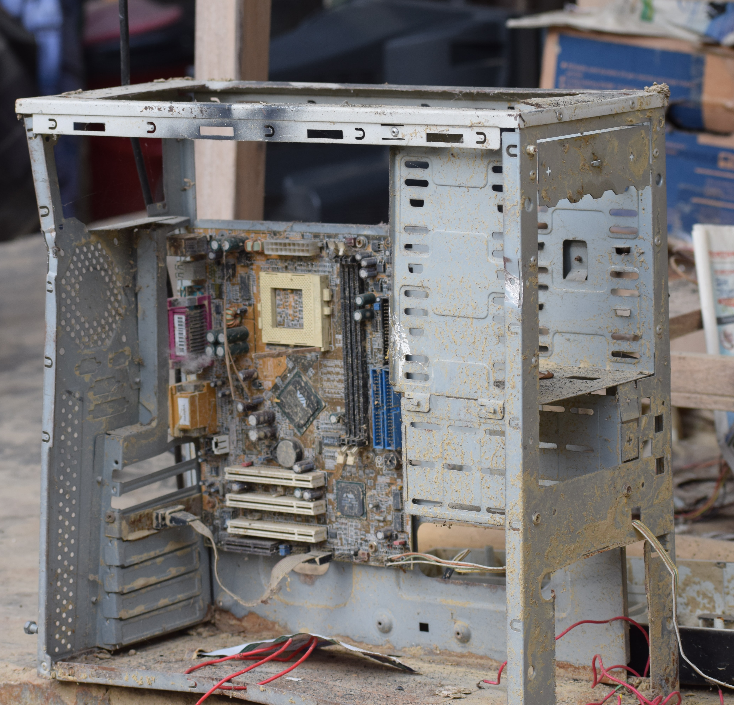
Shared Fate
Are you still there?
Two methods/threads/processes running on the same computer generally have shared fate [Crashed/not]
When two machines in a distributed system can’t talk to each other, how do we know if the other is crashed?
We call this a split brain problem

Slide 19
Network Partitions
The network might fail arbitrarily!
Set A=5
“OK”!
Read A
“6”!
Set A=5
Assume replica failed
A
B
A
B
6
5
7
6
7

Slide 20
CAP Theorem
Pick two of three:
Consistency: All nodes see the same data at the same time (strong consistency)
Availability: Individual node failures do not prevent survivors from continuing to operate
Partition tolerance: The system continues to operate despite message loss (from network and/or node failure)

Slide 21
Byzantine Faults
Unfortunately, still more things can go wrong
Set A=5
“OK”!
Read A
“6”!
Set A=5
A
B
“OK!”
A
B
6
5
7
6
7
Notes:
We can talk more about this kind of failure when we talk about security :)

Slide 22
Distributed Software Engineering Abstractions
Key Question: Consistency vs Availability
Distributed system will never match exact semantics of non-distributed system
For replication do we value more: guaranteed consistency (looks like a single machine) or guaranteed availability (sometimes read stale data)?
For a lock server?
For the order of tweets on twitter?
For partitioning: Where can we draw the line?

Slide 23
Distributing Covey.Town
Partitioning: Separate responsibilities by town
TownID | TownController
Town1 | A
Town2 | A
Town3 | B
Town4 | C
CoveyTownsStore
CoveyTownController “A”
CoveyTownController “B”
CoveyTownController “C”
TownID | Players
Town1 | [player1, player2, player3]
Town2 | [player12, player26, player34]

Slide 24
Distributing Covey.Town
Replicating the Town Controller
Client
New location
CoveyTownController “A”
To be consistent: Everyone must see each player updates in same order (as if just 1 TownController) - but we don’t need that, right?
Client
Updates
TownID | Players
Town1 | [player1, player2, player3]
Town2 | [player12, player26, player34]
Client
New location
CoveyTownController “A”.2
Client
Updates
Client
CoveyTownController “A”.3
Client

Slide 25
Distributing Covey.Town
Replicating the Town Store
What are our consistency challenges?
Each town must have a unique ID
Ideally - distribute towns to controllers evenly?
Should we even do this?
TownID | TownController
Town1 | A
Town2 | A
Town3 | B
Town4 | C
CoveyTownsStore
CoveyTownsStore 2
CoveyTownsStore 3

Slide 26
Learning Objectives for this Lesson
By the end of this lesson, you should be able to…
Characterize the benefits of replication and partitioning in distributed systems
Evaluate the tradeoffs between consistency and availability in distributed systems

Slide 27
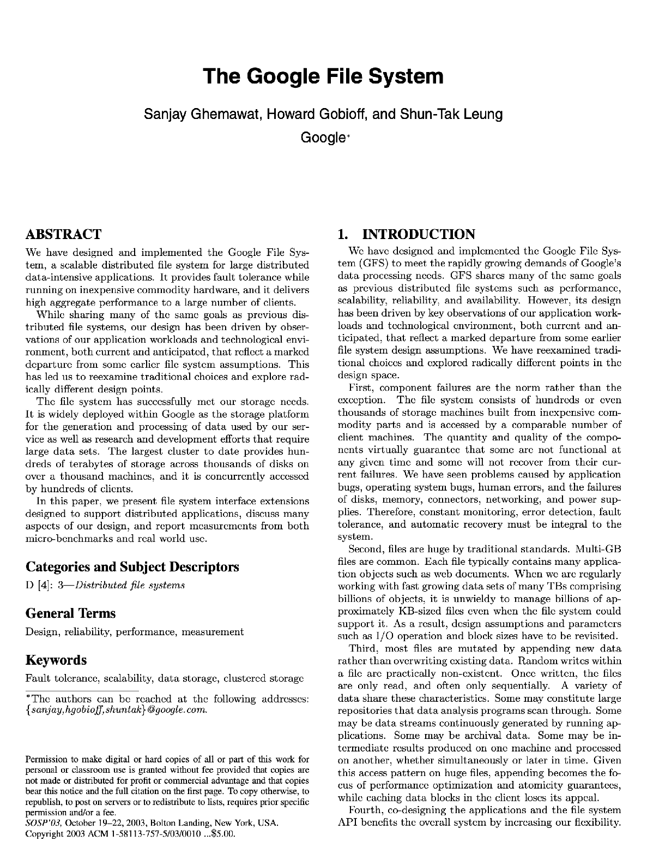
GFS: Google File System
A distributed file system with consistency + performance
“High sustained bandwidth is more important than low latency. Most of our target applications place a premium on processing data in bulk at a high rate, while few have stringent response time requirements for an individual read or write.”
Notes:
Motivation: OK, so NFS is reading/writing who knows, 300MByte/sec. How do I do 900MByte/sec?
Question: What parts of the NFS picture relate to bandwidth? Answer: Single NFS server constrains bandwidth to single-device I/O speeds. Can’t add more servers, because then have this replication problem
Question: How can we trade latency for bandwidth?
Answer: What if we had one special server that knew which servers knew about which files, then split up the files? Pay extra in terms of latency (more requests), but can scale bandwidth. It’s a solution that makes tiers of servers.
Key insight: don’t provide same abstractions as filesystem. Not a POSIX interface, throw away the regular file system client, now use our own client, focus on appending to end of files, big streaming reads

Slide 28
GFS: Google File System
Overall Design: Replication + Partitioning
Replicate:
Each file is stored in multiple places
Partition:
Each server stores only some files
Big files are split into multiple pieces

Slide 29
GFS: Google File System
Replicate & Partition: Master server tracks partitions + replication
Chunk ID | Filename | Part of file | Master Chunk Server | Other Chunk Servers
1 | /foo/bar | 1 of 1 | A, valid for 1 more minute | B, C
2 | /another/file | 1 of 2 | B, valid for 1 more minute | A, C
3 | /another/file | 2 of 2 | D, valid for 1 more minute | C, E
GFS Client
GFS Metadata
ChunkServer
ChunkServer
ChunkServer
ChunkServer
ChunkServer
ChunkServer
ChunkServer
ChunkServer
ChunkServer
ChunkServer
ChunkServer
ChunkServer
ChunkServer
ChunkServer
ChunkServer
ChunkServer
ChunkServer
ChunkServer
ChunkServer
ChunkServer
ChunkServer
ChunkServer
ChunkServer
ChunkServer

Slide 30
GFS: Google File System
Replicate & Partition: Metadata server tracks partitions + replication
Chunk ID | Filename | Part of file | Master Chunk Server | Other Chunk Servers
1 | /foo/bar | 1 of 1 | A, valid for 1 more minute | B, C
2 | /another/file | 1 of 2 | B, valid for 1 more minute | A, C
3 | /another/file | 2 of 2 | D, valid for 1 more minute | C, E
GFS Client
Where is file /foo/bar?
GFS Metadata
List of chunks and their locations
GFS Client
GFS Client
GFS Client
GFS Client
GFS Client
Reads chunks
GFS Client
ChunkServer
ChunkServer
ChunkServer
ChunkServer
ChunkServer
ChunkServer
ChunkServer
ChunkServer
ChunkServer
ChunkServer
ChunkServer
ChunkServer
ChunkServer
ChunkServer
ChunkServer
ChunkServer
ChunkServer
ChunkServer
ChunkServer
ChunkServer
ChunkServer
ChunkServer
ChunkServer
ChunkServer
Notes:
[Draw examples showing other clients, high throughput. Note still have latency of requests to master]

Slide 31
GFS: Google File System
What does this design get us?
Can store petabytes of data
Reading large files: performance scales with number of chunk servers
Each chunk has its own replica set: downtime is hopefully limited to a single chunk
Metadata (list of files and their chunks) can’t be replicated - too slow
Advanced topics in distributed systems: building this without the metadata server

Slide 32
This work is licensed under a Creative Commons Attribution-ShareAlike license
This work is licensed under the Creative Commons Attribution-ShareAlike 4.0 International License. To view a copy of this license, visit http://creativecommons.org/licenses/by-sa/4.0/
You are free to:
Share — copy and redistribute the material in any medium or format
Adapt — remix, transform, and build upon the material
for any purpose, even commercially.
Under the following terms:
Attribution — You must give appropriate credit, provide a link to the license, and indicate if changes were made. You may do so in any reasonable manner, but not in any way that suggests the licensor endorses you or your use.
ShareAlike — If you remix, transform, or build upon the material, you must distribute your contributions under the same license as the original.
No additional restrictions — You may not apply legal terms or technological measures that legally restrict others from doing anything the license permits.

